Slide 1
Commercial Mediation, Arbitration & ISDS in Common Law vs Civil Law Asia:
Two Steps Forward, One Step Back
LUKE NOTTAGE
PhD (VUW), LLD (Kyoto)
Professor of Law, University of Sydney & University of Tokyo

Slide 2
Overview
Background:
  (a) my Todai courses (April-Sept) including Common Law (CL) Asia
  (b) persistent costs & delays in dispute resolution (eg Malaysia & esp. India)
Privately supplied mediation: variability (mostly Singapore & HK)
  So impediments to Singapore Mediation Convention ratifications
  But anyway (some) growth of Med-Arb clauses
International commercial arbitration: still growing
  Delays & esp. costs (despite expedited & ‘green’ arbs, 3rd-party funding, AI): CL influence stronger (so also decline of Arb-Med)?
  As ltd competition from new Int’l Commercial Courts (even Singapore)
ISDS arbitration: more concerns (esp. capital-importers)

Slide 3
Background (a)
Since April, first teaching semester at uTokyo as tenured Professor of Anglo-American law (succeeding Prof Kichimoto Asaka):
  https://japaneselaw.sydney.edu.au/2026/01/cross-appointment-to-utokyo-from-april-2026/
Eibeiho Soron course: (a) revisiting Atiyah & Summers (OUP 1987) ‘Form vs Substance in Anglo-American law’, (b) extending especially to Australian law (hybrid, but still closer to English law)
Eibeiho zemi/tutorials: (a) contract law in (especially CL) Asia – 5 (of 6) OUP books, (b) consumer law in 5 jurisdictions (incl. DR)
Dispute Resolution in Common Law Asia: esp. Singapore, HK, Malaysia (incl Sulu heirs dispute), Brunei, India, PNG, NZ, Australia

Slide 4
(b) Costs & Delays in (Asian) DR
Growth of large law firms:
  (US, UK, China >) India / Australia / Japan > Singapore > HK / NZ / Malaysia
(ii) Spread of billable hours culture
  US >> UK >> HK > Singapore > Australia >> Japan > India
(iii) Delays still in civil litigation ... Impacting also on ADR?
  India >>> Malaysia >> Hong Kong > Singapore / Australia

Slide 5
(i) Top 6 Largest Law Firms — United States 🇺🇸
# | Law Firm | Total Lawyers | Partners | Notes
1 | Dentons | ~5,200* | N/A (Swiss Verein) | Swiss Verein structure
2 | DLA Piper | 4,827 | N/A (Swiss Verein) | Swiss Verein structure
3 | Baker McKenzie | 4,595 | N/A (Swiss Verein) | Swiss Verein structure
4 | Kirkland & Ellis | 3,828 | ~1,451 (all) | 573 equity partners
5 | Latham & Watkins | 3,584 | ~553
6 | Norton Rose Fulbright | ~3,100 | N/A (Swiss Verein) | Swiss Verein structure
Note: Source: NLJ 500 (2025), Pirical Legal (2025). Ranked by total US lawyers. | Approximate figures; headcounts include all fee-earners unless stated. Partner counts include equity and non-equity partners unless specified.

Slide 6
🇬🇧 Top 6 Largest Law Firms — United Kingdom
# | Law Firm | Total Lawyers | Partners | Notes
1 | A&O Shearman | 3,358 | ~450+ | Formed 2024 (Allen & Overy + Shearman & Sterling)
2 | Clifford Chance | 3,319 | ~400+ | Magic Circle
3 | Linklaters | 3,075 | ~400+ | Magic Circle
4 | Freshfields BD | 2,038 | ~300+ | Magic Circle
5 | Eversheds Sutherland | 2,616 | ~424 (all UK)
6 | Herbert Smith Freehills | 2,299 | ~350+ | Silver Circle
Note: Source: Wikipedia UK Law Firms (2023/24 FY data). Ranked by UK-based lawyers. | Approximate figures; headcounts include all fee-earners unless stated. Partner counts include equity and non-equity partners unless specified.

Slide 7
🇮🇳 Top 6 Largest Law Firms — India
# | Law Firm | Total Lawyers | Partners | Notes
1 | Cyril Amarchand Mangaldas | ~900+ | ~100+ | India's largest by headcount (CAM)
2 | Khaitan & Co | ~1,000+ | ~200+ | >1,000 fee earners inc. counsel
3 | Trilegal | ~850+ | ~114 | Fastest growing among Big 5
4 | Shardul Amarchand Mangaldas | ~700+ | ~100+ | SAM – split from Amarchand 2015
5 | AZB & Partners | ~500+ | ~90+ | Offices: Mumbai, Delhi, Bangalore, Pune
6 | J Sagar Associates (JSA) | ~350+ | ~70+ | Gurugram HQ; offices across India
Note: Source: IFLR1000, Legally India, firm websites (2024–25). Foreign firms excluded by regulation. | Approximate figures; headcounts include all fee-earners unless stated. Partner counts include equity and non-equity partners unless specified.

Slide 8
🇦🇺 Top 6 Largest Law Firms — Australia
# | Law Firm | Total Lawyers | Partners | Notes
1 | MinterEllison | ~1,000+ | 248 | Australia's largest by headcount
2 | HWL Ebsworth | ~900+ | 279 | Largest partnership
3 | King & Wood Mallesons | ~700+ | 199 | Part of global KWM network
4 | Ashurst Australia | ~600+ | ~180 | Part of Ashurst global
5 | Herbert Smith Freehills | ~600+ | ~175 | Part of HSF global
6 | Clayton Utz | ~580+ | ~200 | Revenue ~AUD $594m (2024)
Note: Source: CKG Search (2025), LawyerFlux (2025). Ranked by Australian lawyers. | Approximate figures; headcounts include all fee-earners unless stated. Partner counts include equity and non-equity partners unless specified.

Slide 9
🇯🇵 Top 6 Largest Law Firms — Japan
# | Law Firm | Total Lawyers | Partners | Notes
1 | Nishimura & Asahi | ~800+ | ~200+ | Japan's largest full-service firm
2 | Mori Hamada & Matsumoto | ~700+ | ~155+ | 700+ inc. 155 foreign lawyers
3 | Nagashima Ohno & Tsunematsu | ~600 | ~130+ | ~559 lawyers per 2024 data
4 | Anderson Mori & Tomotsune | ~600 | ~120+ | Big Four; founded 1952
5 | TMI Associates | ~400+ | ~80+ | Sometimes called 'Big Five'
6 | Atsumi & Sakai | ~200+ | ~60+ | First Japanese firm with foreign partners
Note: Source: Bloomberg Law (2025), ALB Japan Awards (2024), IFLR1000. Big Four + TMI + Atsumi. | Approximate figures; headcounts include all fee-earners unless stated. Partner counts include equity and non-equity partners unless specified.

Slide 10
🇸🇬 Top 6 Largest Law Firms — Singapore
# | Law Firm | Total Lawyers | Partners | Notes
1 | Allen & Gledhill | ~450+ | ~100+ | Singapore's largest; A&G Asia network >600
2 | Rajah & Tann | ~430+ | ~90+ | R&T Asia network >1,000 fee earners
3 | WongPartnership | ~334 | ~111 | Big Four; 2021 data
4 | Drew & Napier | ~250+ | ~60+ | Big Four
5 | Dentons Rodyk & Davidson | ~200+ | ~50+ | Part of global Dentons
6 | Baker McKenzie Wong & Leow | ~150+ | ~40+ | Joint law venture
Note: Source: IFLR1000, Law Society SG (2023), firm websites. Big Four domestic firms. | Approximate figures; headcounts include all fee-earners unless stated. Partner counts include equity and non-equity partners unless specified.

Slide 11
🇭🇰 Top 6 Largest Law Firms — Hong Kong
# | Law Firm | Total Lawyers | Partners | Notes
1 | King & Wood Mallesons | 231 | 33 | Largest in HK; HK + China + Australia HQ
2 | Deacons | 196 | 53 | Largest domestic HK firm
3 | Linklaters | 168 | 29 | Magic Circle
4 | Baker McKenzie | 168 | 43 | International
5 | Clifford Chance | 162 | 37 | Magic Circle
6 | Johnson Stokes & Master | 125 | 45 | Leading domestic HK firm
Note: Source: Wikipedia List of HK Law Firms by Size (2024). Registered HK lawyers only. | Approximate figures; headcounts include all fee-earners unless stated. Partner counts include equity and non-equity partners unless specified.

Slide 12
🇲🇾 Top 6 Largest Law Firms — Malaysia
# | Law Firm | Total Lawyers | Partners | Notes
1 | Shearn Delamore & Co | 128 | ~35+ | Largest by headcount in 2025
2 | Christopher & Lee Ong | 127 | ~30+ | Rajah & Tann Asia member firm
3 | Skrine | 117 | ~30+
4 | CLO (Lee Hishammuddin A&G) | 115 | ~28+ | Allen & Gledhill affiliate
5 | Zaid Ibrahim & Co | 113 | ~25+ | 4 branches; KPMG Law association
6 | Rahmat Lim & Partners | ~100+ | ~25+ | Allen & Gledhill Malaysia
Note: Source: The Malaysian Lawyer (Dec 2025). Ranked by total Malaysian lawyers. | Approximate figures; headcounts include all fee-earners unless stated. Partner counts include equity and non-equity partners unless specified.

Slide 13
(ii) Partner billable hours rates (UK pounds)
Senior partner, top-tier firm, complex commercial / M&A matter — approximate 2024–25 rates
Jurisdiction
Leading Firms
Partner Rate (£/hr)
Key Note
🇺🇸
USA
Am Law 50 / elite BigLaw
£1,500 – £2,700+
Highest globally; rising fast
🏴󠁧󠁢󠁥󠁮󠁧󠁿
England & Wales
Magic Circle / top US firms
£1,000 – £1,500+
Highest outside New York
🇭🇰
Hong Kong
Magic Circle / top US firms
£700 – £1,200
~75–85% of London
🇸🇬
Singapore
Magic Circle QFLP / top US
£600 – £1,000
Competitive local market
🇦🇺
Australia
Big Six (HSF, Allens, KWM…)
£400 – £750
No Magic Circle presence
🇯🇵
Japan
Big Four (Nishimura, Nagashima…)
£250 – £500*
*Yen weakness suppresses £
* Japan's yen rate (JPY 196–200/£) suppresses the £ equivalent. | USD/£ at ~1.27 for US conversions. | All rates approximate 2024–25.

Slide 14
Rate Comparison
Midpoint of range, senior partner, top-tier firm (£ per hour)
£0
£600
£1200
£1800
£2400
USA
£2,100
£1,500–£2,700+
England
£1,250
£1,000–£1,500+
Hong Kong
£950
£700–£1,200
Singapore
£800
£600–£1,000
Australia
£575
£400–£750
Japan*
£375
£250–£500
* Japan figure reflects current GBP/JPY exchange rate (~JPY 196/£). US figure uses USD/£ ~1.27. Rates competitive in local purchasing-power terms.

Slide 15
+ India's Top Law Firms — Size, Partners & Billing Rates
The 'Big Five' five-star tier (Resight 2025) · IBLJ Billing Rates Survey 2024 · All figures approximate — market evolving rapidly
Firm
Est.
Partners
Total Lawyers
Offices
Key Distinction
Cyril Amarchand Mangaldas (CAM) ★
2015
(est.1917)
160+
1,200+
10 (incl. SG, UAE)
Largest Indian firm. Strong international arb, M&A, PE, capital markets. Global offices in Singapore and Abu Dhabi.
Khaitan & Co
1911
145+
(incl. Dir.)
600+
5
India's oldest major firm. Most profitable per partner. Strong corporate, white-collar. Senior partners on MCIA Council.
Shardul Amarchand Mangaldas (SAM) ★
2015
(est.1917)
188+
884+
7
Strong competition law and dispute resolution. Briefed by UK magic circle and US BigLaw on India international arbitrations.
AZB & Partners ★
2004
100+
500+
5
Highest billing rates (est. 20%+ premium). Strong arbitration, consistent GAR100. Founded by former CAM partners. Very selective.
Trilegal ★
2000
60+
300+
5
Tech, media, telecom, PE specialist. Clean non-family corporate structure. Growing international arbitration practice.
J. Sagar Associates (JSA)
1991
60+
400+
8
Broad full-service. Largest office network. Strong in regulatory, telecom, pharma. Wide geographic reach across India.
Nishith Desai Associates (NDA)
1989
40+
200+
5 (NY, SG,
Munich)
FDI, PE, IP boutique. Pioneer in India-international practice. Offices abroad. Strong on arbitration commentary.
S&R Associates
2006
20+
100+
2
High-end M&A boutique. Founded by former Freshfields and Sullivan & Cromwell lawyers. Highest revenue-per-partner model
IBLJ Billing Survey 2024 (averages)
Jr Assoc.
Sr Assoc.
Jr Partner
Sr Partner
Mgng Partner
USD 142
USD 203
USD 288
USD 348
USD 458
Equity Partner
(top range)
USD 500–750

Slide 16
(ii) DR DELAYS often remain problematic – especially India
Civil litigation timelines, appeal structure and commercial dispute resolution — incl MEDIATION
Metric
🇮🇳 India
🇸🇬 Singapore
🇭🇰 Hong Kong
🏴󠁧󠁢󠁥󠁮󠁧󠁿 England
First instance
(commercial B2B)
5–15 yrs (general courts)
18–36 mths (Commercial Courts)
~9–12 yr national avg
12–24 months
24+ months
18–30+ months
First appeal
(duration)
3–10 yrs additional
(High Court; 62 lakh pending)
6–12 months
12–18 months
12–18 months
Appeal rate
(est. civil)
Very high — ~50–70%+
of civil decrees appealed;
no permission required
~10–20%
~10–20%
~5–15%
(many refused
leave)
Permission to
appeal?
No — s.96 CPC right
to first appeal; SLP
to SC (Art.136)
Limited
(>S$250k: right)
No (CFI→CA)
Yes (DC→CA)
Yes — strict
'real prospect'
test
Specialist
commercial court?
Yes — Commercial Courts Act 2015;
spec. value ≥ ₹3L
Yes — SICC
(international);
High Court
Yes — CFI
Commercial List
Yes — King's
Bench Division
Commercial Ct
Mandatory
pre-trial MEDIATION?
Yes — CCA s.12A (commercial suits); Mediation Act 2023 (all civil/commercial)
Strong judicial
case management;
SMC/SIMC
Court-annexed
scheme; active
judicial push
Court may order; GLO mediation; no mandatory
pre-action
B2B MEDIATION
market maturity
Early stage — cultural resistance; CAMP/IIAM/SAMA slowly growing;
NALSA mandatory route
Mature — SIMC;
SMC; very strong
judicial push
Mature — HMC;
HKIAC; courts
very active
Established and
growing; post-Woolf reforms; active funder mkt
Pending case
crisis severity
Severe — 5.4 crore; rising 0.2 cr/yr;
324-year NITI Aayog clearance estimate
Managed;
active reform
Moderate non-refoulement strain; NRcases
Post-pandemic backlog; 82.9 wks avg to trial;
improving slowly
India's Commercial Courts Act 2015 and esp Mediation Act 2023 are significant reforms — but chronic judge shortages, adjournment culture and ultra-broad appeal rights mean India remains far slower than Singapore, Australia or England for commercial dispute resolution. The mediation culture gap is wide but legislative foundations are now in place.

Slide 17
Also in Malaysia – so eg new ICAD (KL commercial list)
Approximate durations — actual times vary significantly by case complexity, court backlog, and number of interlocutory applications
0m
6m
12m
18m
Tribunal for
Consumer Claims
~2–4 months
Final & binding (JR only)
Magistrates'
Court (civil)
Pleadings
Case mgmt + mediation
Trial
6–18 months
Simple matters 6m; complex longer
Sessions Court
Pleadings + service
Case mgmt + discovery
Trial
12–30 months
Contested matters with applications: up to 3 years
High Court
(standard)
Pleadings
Case management
Interlocutories
Trial + judgment
18 months – 3+ years
Court target: 9 months. Complex cases with multiple applications take longer.
ICAD (International Commercial & Admiralty Division of KL Court)
Active case management
Trial
~9 months target
Chief Justice commitment at ICAD launch (March 2026)
Appeals: High Court: file within 14 days · Court of Appeal: file within 30 days · COA hearing: typically 12–24 months · Federal Court (with leave): add 12–24 months

Slide 18
1. Commercial (supplied) Mediation: disparity
Civil law (Asian) jurisdictions have a longer tradition of court-facilitated mediation – impeded growth of private suppliers (eg Japan)
Cf Common Law jurisdictions – more variable:
  Civil litigation delays led to NSW 90s ‘commercial list’ active case mgt → 2000 power of Sup Ct to compel mediation etc, growth of ‘mediation industry’
    https://www.afr.com/companies/professional-services/pioneering-judge-in-commercial-disputes-dies-20240206-p5f2p1
  Also 90s UK ‘Woolf reforms’ → (i) 2010-2 Singapore / HK court encouragement
    So govt / institutions / universities also developing mediation initiatives (eg SMC + SIMC)
  (ii) Malaysia less successful → stricter referrals (& Commercial list) recently
  + India’s efforts (above) even less successful: longer delays getting even worse!
    Mediation industry ltd, so few (iii) SMC ratifications, (iv) Med-Arb clauses in contracts

Slide 19
(i) Hong Kong mediation {Shahla Ali 2025}
Hong Kong (like Singapore) govt & judiciary actively promoting mediation including for commercial disputes for 15-20 yrs:
  Alexander ‘20 https://www.transnational-dispute-management.com/article.asp?key=2836
Against backdrop of high hourly fees charged by HK lawyers: egs at https://www.hk-lawyer.org/content/rip-hourly-rates
Also ADR promoted in US (federal) courts from eary 1990s, UK courts (Woolf Civil Procedure reforms) late 90s, PRC court practice (where judges themselves actively encourage settlement, rather than separate mediator especially before litigation as in Anglo-American practice)
HK Civil Justice Report 2004 -> Pilot schemes (eg construction) from 2006 -> 2009 Reform report & 2010 Court’s ‘Practice Direction’ 31: parties can have COSTS awarded against them by Court if unreasonably refuse to engage in mediation when proposed …

Slide 20
… Subsequent case law:
  What if party thinks ‘my case is too strong’? ‘I’m stubborn’? ‘Settlement negotiations already failed?’ Rarely enough!
  Burden of proof to show why didn’t try mediation? On party refusing it
  Courts also can help parties to secure a mediator if agreed
  And say appointment plus attendance in at least one mediation session are minimum requirements
Dept of Justice ’Mediation Code’ 2010 adopted into Rules of many bodies
Mediation Ordinance 2012 reinforces Confidentiality obligations
  But doesn’t add special procedure for enforcing mediated settlement (so just like any other breach of contract) [same gap in UNCITRAL Model Law]

Slide 21
Effectiveness of this (still light-touch) Court-annexed mediation scheme?
Legal profession originally not very keep and some still not
But 2011-2014 1446 cases mediated in DCt (617 full settlement) 2265 in CFI (938, so higher % settled), plus settlement rate grew 38 to 48%
Around 35-45 days to complte; 4-6 hours & $HK20k if reached settlement
World Justice Project and other ‘rankings’ suggest improvements in efficiency for civil litigation 2014-2022

Slide 22
(ii) Cf Malaysia: more recent boost to Court-Annexed Mediation
Formally embedded in civil procedure: Rules of Court 2012 (Order 34) & esp. Practice Direction No. 2/2022
Legal Framework
How It Works in Practice
Order 34 ROC 2012
1
Step 1: Direction
Pre-trial case management: court may direct mediation at case management stage as part of trial preparation directions.
At pre-trial case management, judge directs parties to attempt mediation before trial date is fixed. Parties have no absolute right to refuse.
PD 2/2022
2
Step 2: Choose type
Practice Direction No. 2 of 2022 (Chief Justice): comprehensive mediation framework for all civil courts — subordinate and superior.
Parties select judge-led, institutional (eg. AIAC), or private mediator. For private, parties notify court within 7 days of agreement.
Three types
Judge-led mediation (Annexure C) · Institutional mediation at accredited ADR centre (Annexure D) · Private mediation (Annexure E)
3
Step 3: Mediation
Not mandatory by law
Mediator facilitates. In judge-led mediation, the same judge does NOT preside at trial if mediation fails — 'without prejudice' protection preserved.
No mandatory pre-action mediation required by statute — BUT judges now push for mediation before fixing trial dates (Chief Justice directive).
4
Step 4a: Success
Free option
Settlement agreement → filed with court as consent order or judgment → fully enforceable. Parties report outcome to court.
Mediation conducted by a Judge or Registrar at the Palace of Justice (Putrajaya) is a FREE service. No fee for litigants.
5
Step 4b: Failure
Multi-stage
Case returns to court. Mediation submissions inadmissible. Trial proceeds in the normal way.
Mediation can be directed at pre-trial case management, during trial, and even on appeal. Not a one-time step.
Outcome
6
(2018 UN) Singapore Mediation Convention
If successful: consent judgment or recorded settlement — enforceable as court order. If unsuccessful: mediation documents inadmissible at trial.
Malaysia has SIGNED, NOT RATIFIED, so international settlement agreements can’t be directly enforced by the High Court — need to sue on the contract.

Slide 23
(iv) Indian Courts & Govt Belatedly Promoting Mediation (2018, 2023)
Evolving from 'court may refer' (1947) to mandatory pre-litigation B2B mediation (2018) & comprehensive Mediation Act (2023)
1947
Industrial Disputes Act
First statutory conciliation in India — government-appointed conciliators for labour disputes. Root of India's mediation history.
1996
Arbitration & Conciliation Act s.30
Tribunal may encourage settlement at any time. Part III (ss.61–81) governs conciliation. First significant statutory basis for commercial ADR other than arbitration.
2002
CPC s.89 — General Court Referral Power
CPC amendment: courts MAY refer disputes where elements of settlement exist to — arbitration, conciliation, judicial settlement, mediation, or Lok Adalat.
NALSA empanels mediators in court-annexed mediation centres across India.
2013
Companies Act s.442 — Mediation Panel
Central Government maintains Mediation & Conciliation Panel for NCLT/NCLAT cases. Parties may apply for referral to panel. Court may suo motu refer to mediation at any stage of company proceedings.
2018
Commercial Courts Act s.12A —MANDATORY ★
MANDATORY pre-institution mediation for ALL commercial disputes ≥ INR 3 lakhs (unless urgent interim relief needed). 3-month period via Legal Services Authorities. Settlement recorded = decree of court. First mandatory commercial mediation in India.
2019
Consumer Protection Act — Mediation Cells
District/State Commissions may refer to mediation at first hearing or any later stage. Consumer Mediation Cells attached to each Commission (ss.74–79). 30-day mediation window. No fee for consumer. Strong judicial push toward early settlement.
2023
Mediation Act 2023 ★ (but n/a to govt disputes – despite major litigant, & MoF 2024 policy to limit arbitration to smaller govt procurement cases)
Full legislation: VOLUNTARY pre-litigation mediation for all civil/commercial disputes. All Courts/tribunals MAY refer at any stage irrespective of agreement. Online mediation recognised. 120-day limit (+60 extendable). Mediation Council of India to register/regulate mediators. Overrides CPC/A&C Act/Consumer Act on conduct of mediation. Includes confidentiality, & Mediated Settlement Agreements enforceable as court decrees. May help India to ratify the (signed) Singapore Convention …

Slide 24
Why Commercial Mediation Lagged in India Despite Huge Court Delays
India's court system is far slower than Singapore, HK or Australia — yet privately supplied B2B mediation remains far less popular than in those jurisdictions
Cultural preference for adversarial adjudication
Enforceability uncertainty (now partly addressed by Mediation Act 2023)
Indian legal culture — both parties and lawyers — overwhelmingly prefers court adjudication. 'Going to court' retains social legitimacy; mediation is perceived as a sign of weakness or inability to fight. This attitude is deeply rooted and slow to change despite legislative nudges.
Before 2023, mediated settlement agreements had uncertain domestic enforceability - no equivalent of Singapore Convention (not yet ratified) for domestic law. Parties feared non-compliance and preferred the coercive force of court orders over voluntary mediation settlements.
Lawyer economics — no incentive to resolve quickly
B2B parties prefer arbitration over mediation
Lawyers' fees in India are typically time-based (adjournment culture) or case-outcome-based — not solution-based. There is little financial incentive for lawyers to recommend mediation, which shortens the dispute lifecycle and reduces fee income. Plaintiff bars benefit from prolonged litigation.
For high-value B2B disputes, Indian parties strongly prefer arbitration (binding, enforceable, private, final). Mediation is seen as a weak optional step. The arbitration ecosystem (MCIA, DIAC, ICADR, IIAM) is more developed than mediation (slowly now improving) for commercial matters in India.
Compared to Australia / Singapore / Hong Kong
Mediator quality concerns and shortage of qualified practitioners
Australia: strong mediation culture built over 30 years; litigation funders encourage it; NSW Equity Division referral rate 57.3% (2023 record). Singapore: SIMC active; judicial case management pushes mediation firmly into pre-trial stage. HK: court-connected scheme mature since 2010. India: mediation only now gaining legislative momentum — cultural shift will take a generation.
Commercial parties do not trust the quality or domain-specific knowledge of Indian mediators (noted in SIDRA 2019 analysis; ABA 2026 article). Court-appointed mediators under s.89 CPC often lack commercial expertise. CAMP and IIAM training is improving this, but slowly. NALSA pool is large but not commercially specialised.
Government non-participation (the largest dispute party):
Government and PSUs — the largest party class in Indian disputes (~50% of all pending cases) — have been largely excluded from or unwilling to engage in mediation. Post-June 2024 MoF circular this is beginning to change for procurement disputes, but implementation is early-stage and HLCs are still being established.

Slide 25
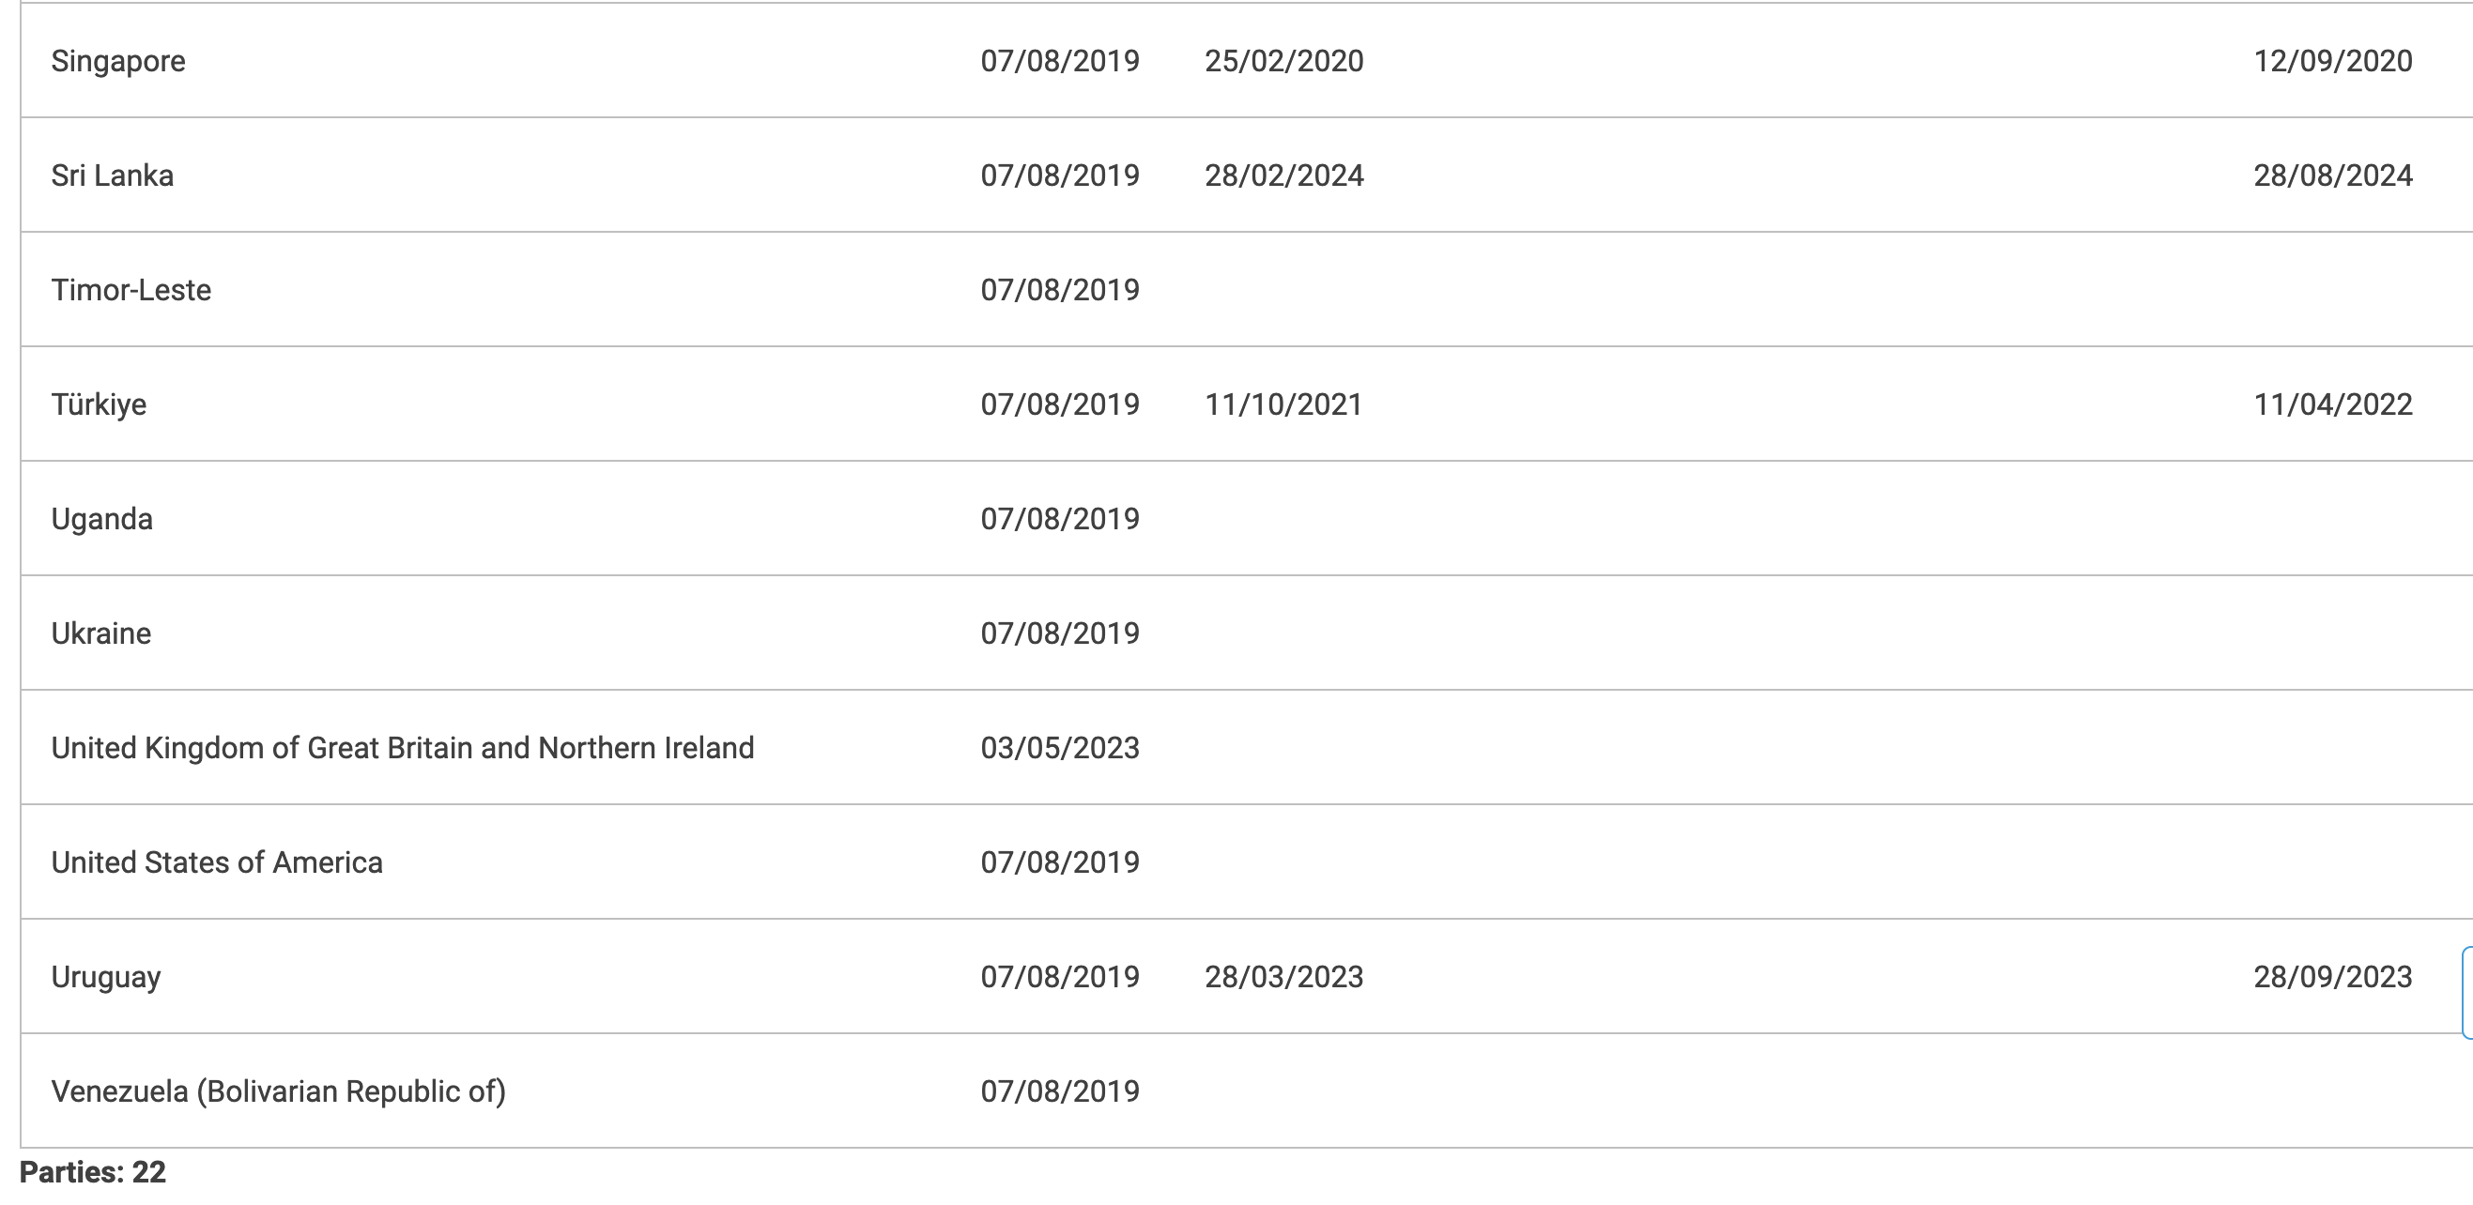
(iv) Mediation disparity impedes SMC ratification https://uncitral.un.org/en/texts/mediation/conventions/international_settlement_agreements/status

Slide 26
(v) Med-Arb also less popular in India, Malaysia
If a straightforward Mediation clause is not directly enforceable as (both) states have not ratified the SMC, it can lead to an award enforceable under NY Convention if there is a mediation clause combined with (if no settlement or enforcement) arbitration
But such Med-Arb clauses are less likely to be agreed & certainly proposed by (law) firms in eg Malaysia & India, since they are less familiar with the Mediation step for B2B disputes
Also unclear if their courts will follow (English →) HK & now Singapore* in presuming the arbitrators (not courts) have jurisdiction to decide if parties complied with agreed pre-arb steps like mediation:
  * https://legalblogs.wolterskluwer.com/arbitration-blog/dro-v-drp-singapore-aligns-with-international-consensus-on-jurisdiction-admissibility-dichotomy-on-preconditions-to-arbitration/

Slide 27
2. Intl Commercial Arbitration: mostly growing
Singapore now a world leader (after quite slow start)
Hong Kong also keeping up, thanks to China trade: fewer cases but higher-value (but can it keep up given geo-politics?)
Vietnam (Intl Arb Centre) & Korea (KCAB Int’l) have grown (less), thanks to their bigger companies & govt pushing for seats there
Malaysia (& Thailand, Australia) & Japan (too little, too late?) have been less successful in attracting intl arb cases
  But are now more credible seats, useful for their cos negotiating contracts
India too: laws improving on case law but still struggling trying to shift from ad hoc arb (led by slow/dear ex-judges) to institutional

Slide 28
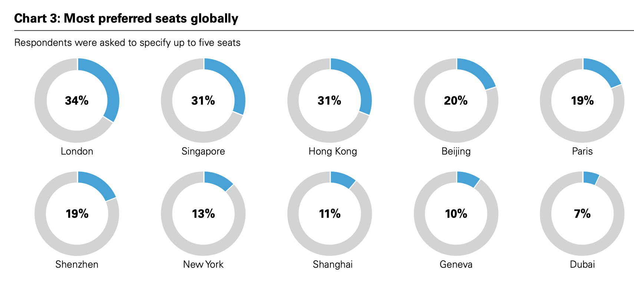
https://www.qmul.ac.uk/arbitration/research/2025-international-arbitration-survey/

Slide 29
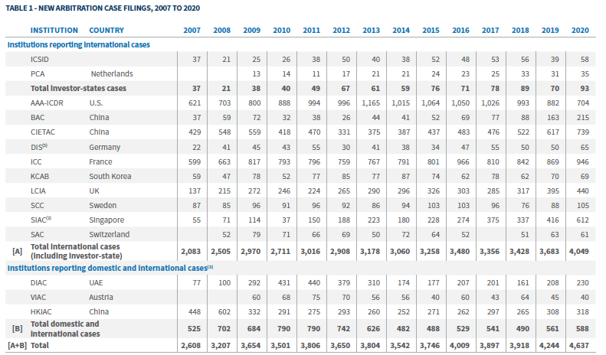
Cf pre-Pandemic: https://www.fticonsulting.com/insights/reports/international-arbitration-after-pandemic

Slide 30
Institutional Comparison (2024)
Institution | Total Cases | Intl./Foreign | % Intl. | Dispute Value | Jurisdictions
SIAC | 625 | 566 | 91% | USD 11.86bn | 72
HKIAC | 352 arb. | ~269 | 76% | USD 13.6bn | 53
CIETAC | 6,013 | 758 | 13% | CNY 81.1bn (f-r) | 77
SCIA | 14,518 | 520 | 4% | CNY 51bn (intl.) | —
BAC/BIAC | 14,060 | 277 | 2% | USD 1.4bn (f-r) | —
KCAB | 349 | 48 | 14% | USD 548m | —
VIAC | 478 | ~89 (est.) | ~19% | — | —
MCIA | 34 | — | — | USD 258m | —
Notes: "f-r" = foreign-related (broader than strict ”international” ie where parties from different states – includes eg foreign subsidiary disputing with local party).
HKIAC 269 = 76.4% of 352 arbitrations. VIAC estimated from 18.63% of 478. All figures reported; not strictly comparable.
Notes:
Walk the audience through the table row by row. Emphasize that SIAC 91% vs CIETAC 13% reflects very different institutional profiles and case mixes, not quality differences.

Slide 31
ASIA-Linked International Arbitration Filings: Recent Institutional Comparison
 | ICDR | ICC | LCIA | SIAC | HKIAC
Metric basis | Asian-party count (not unique cases) | Regional share proxy (% of parties × filings) | Regional share proxy (% of parties × filings) | Int'l case count (Asia-based; no separate Asian-party figure) | Cases with ≥1 Asian party (derived from 'no Asian parties' %)
2022 | ≤264 parties (755 int'l B2B cases) | ~174 (695 cases; 25% Asia-Pac) | ~70 (293 arbs; 24% Asia) | ~314 int'l cases (357 total; 88% int'l) | ~324 (344 arbs; 5.8% no Asian)
2023 | ~351 parties/matters (848 int'l cases) | ~218 (870 cases; 25% Asia-Pac) | ~26 (327 arbs; 8% Asia) | 614 int'l cases (663 total; 93% int'l) | ~254 (281 arbs; 9.6% no Asian)
2024 | N/A (811 total cases) | ~183 (831 cases; 22% Asia-Pac) | ~29 (318 arbs; 9% Asia) | 566 int'l cases (625 total; 91% int'l) | ~301 (352 arbs; 14.5% no Asian)
2025 | 290 parties (725 int'l arbs) | N/A (prelim: 881 cases; Asia-Pac share rising) | N/A (no report found) | ~789 int'l cases (886 total; 89% int'l) | ~335 (388 arbs; 13.7% no Asian)
Takeaway | Stable ~260–350 Asian parties/yr | Stable ~180-220 (22–25%) Asia-Pac | Low & declining Asia share | Strong growth; Asian users dominant | High levels: ~250–335 cases/yr (cleanest data series)
Methodology & caveats: Counts are not perfectly comparable — institutions report different denominators (unique cases, party counts, international-case shares, or regional shares). HKIAC provides the cleanest annual Asian-party case series (publishes % with no Asian parties). SIAC does not publish a comparable Asian-party count; international cases shown as proxy. LCIA & ICC data are proxies from regional party-share percentages applied to total filings.
Sources: Institutional annual reports/statistics and public summaries; figures rounded.

Slide 32
Delays & (esp.) costs, yet ICArb keeps growing!
Many Arb Rules have introduced ‘expedited’ arbitration track (4-6 months for award by sole arbitrator appointed by institution), automatic eg <$5m in dispute (ACICA, SIAC … but HKIAC still opt-in!)
  Latest SIAC Rules added extra-expedited (3 months if <$1m)
  But major costs are still from lawyers, not arbitrators (let alone admin fee)
Unclear if third-party funding (S’pore, HK – also with lawyer-funding, now Malaysia – despite Sulu saga!) leads to more or less delays & costs
Unclear if ‘green arbs’ & gender (not professional!) diversity initiatives (eg ACICA ‘carbon protocol’, HKIAC) mean more or less costs in ICArb
Unclear re AI, yet already used esp. for evidence/mgt (QMUL survey)
‘Arb-med’ faded, except PRC arbs; instead some SIAC Arb-Med-Arb

Slide 33
WHY? NY Convention (for enforceability) means ICArb lacks competition
Even from Singapore Intl Commercial Court · let alone more recent CICC or (even less international) China local IC tribunals
SICC
CICC
China Local IC Tribunals
Established
Jan 2015
Jun 2018
From Nov 2020
(16 cities by early 2026)
Total cases
Low hundreds (all modes, estimated)
42 (8 years)
27 by Mar 2023
Not published
(bulk of ICC network work)
Opt-in cases
BUT not separately reported - so likely few?
Very few?? + threshold ≥ RMB 300 million
N/A — compulsory
territorial jurisdiction
Foreign lawyers
Permitted (offshore cases)
Not permitted (advisory role only)
Not permitted
Foreign judges
Yes — 24 international (part-time)
None
None
Language
English
Mandarin only
Mandarin
Appealable
Yes (to Singapore Court of Appeal – local judges)
No (final)
Yes (intermediate court)
Jurisdiction basis
Consensual (pure opt-in + supervisory court for arbitration: 2023 SIAC model clause) + transfer from regular Sing HCt (most common so far)
Opt-in (high value) + transfer, SPC discretion
Compulsory — foreign-related
cases channelled automatically
Data sources: Finder / USALI (Jan 2026); Sun (2024); USCC (Feb 2023); SICC judiciary.gov.sg; Supreme People's Court Monitor; cicc.court.gov.cn.

Slide 34
3. ISDS Arbitration: Significant concerns
Allows direct claims by foreign investor of a home state against home state, if latter violates substantive protections (eg non-discrimination, expropriation, unfair process eg denial of justice in host state courts), usually under BIT or FTA investment chapter.
ISDS still promoted by major FDI-exporting states: Japan, Korea
Often too by those also quite FDI-importing: China, Malaysia (Sulu?)
ISDS disliked by largely FDI-importing states, as they started to incur inbound claims: India + Indonesia (both terminating some old BITs) + Vietnam (but all kept ISDS for new treaties), NZ & (sometimes) Australia
  Complicating pan-Asian FTA negos: ISDS maintained largely in CPTPP, for now in ASEAN-ANZ FTA Protocol, but not yet in (ASEAN+6) RCEP – so 2x ‘work programs’

Slide 35
CPTTP: re-signed 2018 (after Trump 1.0 un-signed for USA)
  Basically similar to 2016 TPP, but no ISDS for govt investment contracts (so must negotiate separate arb clause – could be worse eg for transparency!)
  NZ from 2017 went anti-ISDS but for ‘future treaties’, so still agreed to CPTPP ISDS although with some extra bilateral carveouts (not just with Aust)
  Only three known ISDS claims - through ICSID:
    Canadian investors vs Mexico (2023 re renewable energy – but suspended, 2024 mining)
    Australians (Riversdale & Hancock) vs Canada (2024 re mining)
  PS only one (inter-state) trade dispute: NZ vs Canada (2022-3, dairy tariffs)
AANZFTA 2nd Protocol also not ‘new treaty’ for NZ govt (or Australia’s from 2022) so retains ISDS, but ‘work program’ to keep discussing …

Slide 36
Little scope seemingly for innovations in FTA/BIT negos/drafting:
Med-Arb provisions remain rare: compulsory mediation before ISDS arb in new Aust-Indonesia FTA 2019, but not Aust-HK despite HK agreeing on it with (from?) UAE)
Little interest in my proposal for intra-regional FTAs to adopt EU-style ‘investment court’ compromise to ISDS: parties (investors) can’t appoint arbitrators, instead only states pre-select panel of ‘judges’ who are then selected to resolve claims (still brought directly by investors vs host states) & to hear any appeals
  Despite Vietnam and Singapore agreeing to this with EU for FTAs
Is ongoing significant intra-regional (& global) controversy over ISDS good or bad for promoting wider arbitration and mediation / ADR?

Slide 37
CONCLUSIONS: Across (Austral-)Asia …
‘Two Steps Forward …’
1. (Int’l & maybe domestic) Commercial Arbitration mostly growing
  despite persistent delays and especially costs
2. (Privately-supplied tho’ court-promoted) Commercial Mediation more disparate
‘… One Step Back’
3. ISDS Arbitration facing greater concerns

Slide 38
Key refs (& disclaimer: Claude Pro & Harvey AI!)
‘The Prospects and Challenges for International Commercial Arbitration’ 6 Japan Commercial Arbitration Journal 35-62 (Sept 2025) https://ssrn.com/abstract=5332146
  Horiuchi & Teramura trans: JCA Jyanaru (2026 forthcoming)
  Based on Japanese judicial training lecture: see (with PPTs, also in Japanese) https://japaneselaw.sydney.edu.au/2025/03/the-promises-and-pitfalls-of-international-commercial-arbitration/
‘Cross-Fertilisation in International Commercial Arbitration, Investor-State Arbitration and Mediation: The Good, The Bad and the Ugly?’ 50(3) Monash Univ L Rev (2025) https://ssrn.com/abstract=4872129
  Based on ADR Address in the NSW Supreme Court: see (with PPTs) https://japaneselaw.sydney.edu.au/2024/02/cross-fertilisation-in-international-commercial-arbitration-investor-state-arbitration-and-mediation-the-good-the-bad-and-the-ugly/
‘Australia’s Ambivalence Again Around Investor-State Arbitration: Comparisons with Europe and Implications for Asia’ 39(2) ICSID Review 320-46 (2024) https://doi.org/10.1093/icsidreview/siae029
  Related works-in-progress also at https://japaneselaw.sydney.edu.au/2026/01/cross-appointment-to-utokyo-from-april-2026/

