Slide 1
“Impact of the EU’s Traceability Regulations for Japan’s EV
Battery Manufacturers, Australia’s Critical Raw Materials
Suppliers, Global Trade and Dispute Resolution”
LUKE NOTTAGE
PhD (VUW), LLD (Kyoto)
Professor of Law, University of Sydney & University of Tokyo
For: Goethe University Frankfurt, 2 November 6.15pm, RuW 2.102

Slide 2
Background
Critical raw materials (CRM) are essential for the energy transition yet create technological, geopoliticial and legal challenges
Supply chain traceability regimes generate solutions but also tensions
1. EU (EV) Battery Regulation presents one (centralised, unilateralist) approach: Huang & Nottage (Nov 2025) RECIEL, https://onlinelibrary.wiley.com/doi/10.1111/reel.70027?af=R
2. UN(ECE) is more cosmopolitan: Huang co-led White Paper (Sept 2025) https://unece.org/trade/documents/2025/09/white-paper-digital-product-passports-and-critical-raw-materials-batteries ...

Slide 3
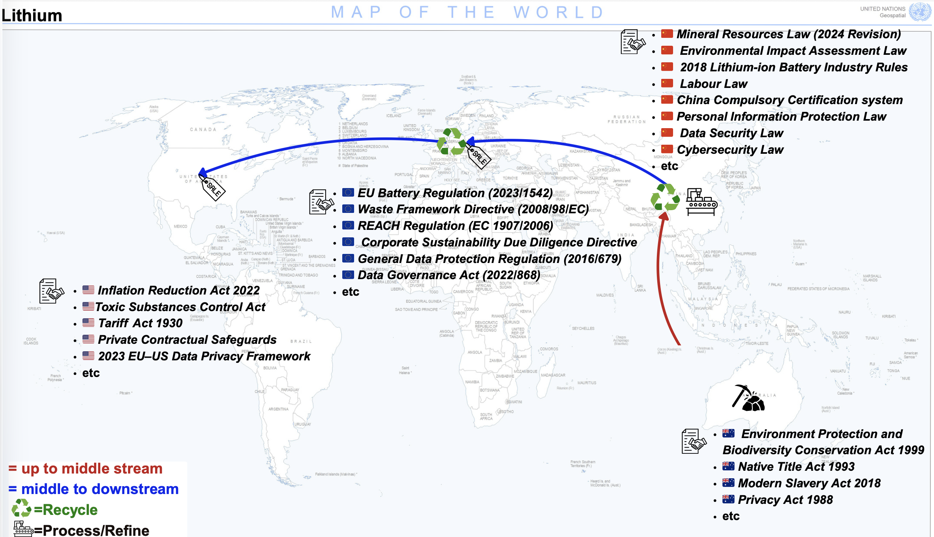

Slide 4
eg Australia
… 3. BOOK FOR HART · STUDIES IN PRIVATE INTERNATIONAL LAW – ASIA
Upstream · mining
International Traceability Law
China ... eg Japan?
Midstream · processing & manufacturing
Disclosures and Dispute Resolution in Critical Raw Materials Value Chains
especially EU … cf US
Downstream · consumption
Jeanne Huang (USydney) & Luke Nottage (USydney & UTokyo)
Asia
Recycling

Slide 5
NEW FIELD
What is international traceability law?
New legal regimes require firms to trace and disclose verifiable data about products, their production & the entities involved across the life cycle, usually to advance national security & ESG goals.
Case study: CRMs
EU Battery Regulation
The core problem
Lithium, copper, cobalt, nickel and rare earths, essential for the energy transition, AI and robotics, and defence.
From February 2027, EV batteries imported into the EU must carry a digital product passport (DPP) covering (a) carbon intensity and (b) other responsible sourcing.
When one jurisdiction's regime collides with partner states' laws along global value chains, serious legal conflicts arise.
Huang & Nottage — International Traceability Law (Hart, Studies in Private International Law – Asia)

Slide 6
PART A · INTRODUCTION (CH 1–2)
Why regimes proliferate, and where they collide
Drivers
Conflicts
Sustainability and the circular economy: consumers, not taxpayers, pay for greener products
Competitiveness: more manufacturing and recycling in the EU, and processing in Australia rather than mainly in China
Resilience and security amid wider "resource wars"
Technical: carbon intensity after repeated recycling, or mine-level soil and water scores
Equity: compliance costs that fall on Global South suppliers (especially eg SMEs), prompting "neo-colonialism" concerns
Legal (the book's main concern): national security and privacy laws that block cross-border data flows for DPPs
Huang & Nottage — International Traceability Law (Hart, Studies in Private International Law – Asia)

Slide 7
THE BOOK'S FRAMEWORK
A spectrum of traceability models
More centralised → more interoperable and flexible
Ch 3
Ch 4
Ch 5
Ch 6
Ch 7
Centralised
Quasi-centralised
Federated
Quasi-decentralised
Decentralised
EU DPPs; China's export approval system
EU recognition of 'adequate' partner laws
International standards plus central authorities
Treaty with procedural standards only
Soft law; no binding treaty
Huang & Nottage — International Traceability Law (Hart, Studies in Private International Law – Asia)

Slide 8
PART B–C · CH 3–4
Centralised and quasi-centralised models
Centralised (Ch 3)
Quasi-centralised (Ch 4)
EU: the consumption market sets substantive DPP standards for all value-chain participants worldwide, with textiles and other products to follow under the Ecodesign Regulation.
China: CRM exporters must disclose to PRC authorities information including their partners' end uses.
Problem: one-way data flow, no interoperability, and resulting legal conflicts.
Mutual recognition agreements under which the EU accepts partner-state regimes as sufficiently similar, by analogy with EU privacy "adequacy" decisions such as Japan's.
Data can flow both ways, with exceptions for fraud.
The EU may give foreign authorities' findings anything from no deference to full deference.
Huang & Nottage — International Traceability Law (Hart, Studies in Private International Law – Asia)

Slide 9
PART C · CH 5–7
Towards decentralisation
Federated (Ch 5)
Quasi-decentralised (6)
Decentralised (Ch 7)
Internationally agreed standards, with a central authority in each state assessing and passing on data. Analogues: CITES, Basel, Kimberley Process. Promising for defence data shared among allies such as the US, Japan and Australia.
A treaty without uniform substantive standards. With a central authority: the Apostille Convention. Without one: the New York Convention, which permits refusal for fraud, serious procedural flaws or public policy.
No binding treaty or central authority. Draws on foreign-judgment recognition and soft law (UNCITRAL, UNECE Rec 46, ISO). An EU battery might then carry three QR codes based on EU, Chinese and Australian standards.
Huang & Nottage — International Traceability Law (Hart, Studies in Private International Law – Asia)

Slide 10
International Traceability Law:
Addressing legal conflicts to access verifiable data in international value chains
Quasi-Centralised Model: the central jurisdiction recognizes the law of key states participating in value chains
Federated Model: a multilateral agreement between jurisdictions in value chains harmonizing substantive and procedural laws
Decentralised Model: unilateral recognition of foreign regulatory outcomes under national law or industrial best practice
Centralised Model: the whole mineral value chain complying with the law of a key jurisdiction. Lack of interoperability.
Quasi-Decentralised Model: a multilateral agreement between jurisdictions in value chains harmonizing procedural laws and provide mutual recognition of regulatory outcomes
e.g. The China Processing Power Model and the EU Consumption Market Model
e.g. The EU General Data Protection Regulation Adequacy Decision with Japan, the EU conflict minerals regulation
e.g. The CITES Convention to trace endangered species, the Cape Town Convention to trace international interests in mobile equipment, the Basel Convention to trace hazardous goods
Interoperability by Mutual or Unilateral Recognition
of Foreign Law/Practice
e.g.The New York Convention to trace and recognize foreign arbitral awards; the Apostille Convention to trace foreign public documents
e.g. Australian common law to recognize and enforce foreign judgments
Notes:
Huang Nottage Traceability of Critical Mineral Lithium chart
The Cape Town Convention (2001) establishes a uniform international regime for the creation, registration, priority, and enforcement of security interests in high-value mobile equipment, supported by a global electronic registry and sector-specific protocols to facilitate cross-border asset-based financing.
International Registry
A central feature is the creation of a global electronic registry where creditors can register their interests.
The International Registry of Mobile Assets allows creditors to:
register their security interests
establish priority over competing creditors
verify existing interests in an asset
Priority is generally determined by the rule:
“first to register has priority.”
Core Mechanism: International Interests
The Convention introduces the concept of an “international interest.”
An international interest arises when a creditor obtains a security interest through:
a security agreement
a title reservation agreement
a leasing agreement
These interests are recognized across all contracting states.
A central innovation is the International Registry, an electronic notice-based system recording interests and determining their priority on a first-to-register basis. Creditors may, upon debtor default, repossess or sell equipment and exercise rapid insolvency remedies, provided such actions comply with declarations made by contracting states. This harmonized registry reduces credit risk and borrowing costs for airlines, rail operators, and satellite financiers

Slide 11
PART D · CH 8–9
Private (re)ordering along value chains
1
Risk allocation
EU importers will seek warranties of data accuracy and indemnities for fines from upstream and downstream partners
2
Drafting responses
Eg hardship clauses if EU standards change? subject to bargaining power etc
3
Governing law
Eg the UNIDROIT Principles of International Commercial Contracts as applied ‘lex mercatoria’? Which common law courts generally will not apply so combine with …
4
Arbitration
Also: better enforceability, neutrality, flexibility and confidentiality. BUT costs & delays; which seat, rules (SIAC > HKIAC? ICC?) and (multi-competency?) arbitrators?
5
Mediation and hybrids
Roles for Arb-Med (yet mostly now ltd to PRC), Med-Arb (yet even in some common law states ltd B2B mediation experience) other ADR, especially in Asian forums?
Huang & Nottage — International Traceability Law (Hart, Studies in Private International Law – Asia)

Slide 12
PART E · CH 10 AND KEY FEATURES
What the book contributes
The book argues, both empirically and normatively, that traceability regimes such as those for CRMs will and often should become less centralised. It moves beyond ex post conflict of laws towards ex ante regulatory interoperability.
First overview
CRM focus
Trade corridor
Covers national, regional, multilateral and unilateral-recognition models, using analogies from private international law.
Analyses the most developed and controversial centralised regimes: the EU Battery Regulation and China's export approvals.
Australia → China/Japan → EU/US → Asia recycling, including non-state actors and contracting firms.
Huang & Nottage — International Traceability Law (Hart, Studies in Private International Law – Asia)

Slide 13
THE PROJECT
Authors, method and audience
Huang: co-lead of the UNECE-UN/CEFACT Critical Minerals Traceability and Sustainability Project; led its 2025 White Paper on DPPs and CRMs for batteries, co-authored with Nottage
Already more than 40 stakeholder interviews and workshops, including UN, OECD and the Commonwealth Secretariat
Method: conceptual and doctrinal comparison, informed by scientific, business and geopolitical realities
+ Pending grant application (expanding interviews etc, with PhD student): Australian Research Council 3-year ”Discovery Project”, outcome announced in January 2027 …
… already let us know if interested in sharing experiences and views on our topics!
THANK YOU FOR YOUR ATTENTION & INVITATION!
120,000
words, 10 chapters
Jan 2028
manuscript submission
None
directly competing books
Huang & Nottage — International Traceability Law (Hart, Studies in Private International Law – Asia)

