Slide 1
The Interface of Inquests with
Consumer Law and Policy
The Takata Airbag Debacle in Australia & Beyond
Professor Luke Nottage
University of Sydney & University of Tokyo Law Schools
49(3) UNSWLJ (2026) https://ssrn.com/abstract=6261598

Slide 2
1. Overview
Takata airbags: the largest most complex consumer product recall, globally & in Australia
Australia's consumer product safety regulation (Part 2)
The Takata airbag saga (Part 3)
The NSW Coronial Inquest 2019-2021 into Australia's first Takata fatality (Part 4)
The aftermath & impact of the Inquest (Part 5)
Other product-related inquests in Australia & analogues abroad (Part 6)
Key argument: coronial inquests deserve wider scrutiny as they can identify serious product risks, assist compensation claims, promote regulatory learning, & inform consumer product safety law reform

Slide 3
2. Australia's Consumer Product Safety Regime – Background
Trade Practices Act 1974 (now nationwide Competition & Consumer Act 2010 / Australian Consumer Law "ACL")
Pre-market controls: mandatory design/info standards for high-risk products (ACL s 104)
Post-market controls: product bans, mandatory recalls, voluntary recall notifications (s 128), mandatory reporting of serious injuries/deaths (s 131) - narrower than EU or Canada (eg not for "near misses")
ACCC manages Product Safety Australia (PSA) website for consumer goods recalls
Transport Department (TD) manages vehicle recalls website (since July 2021, Road Vehicle Safety Act 2018)
MOU between ACCC & TD (revised March 2023) governs coordination

Slide 4
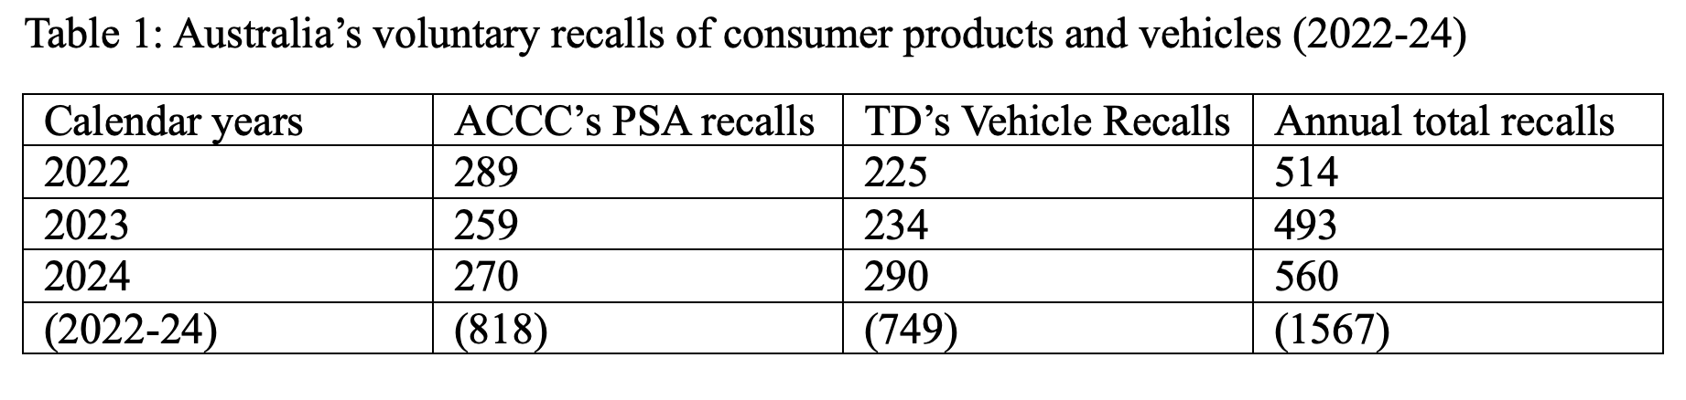
Recent Reform Initiatives
2019: Treasury consultation to add EU-style General Safety Provision (GSP) to ACL – did not progress
2021-2024: reform to allow easier transplanting of foreign safety standards (ACL s 104 amended)
2021-2024: consultation on civil penalties for failing to provide remedies for consumer guarantee, incl. safe products (ACL Part 3-2) – did not progress
From mid-2024: "designated complaints" (super-complaints) mechanism – 3 consumer NGOs (incl. Choice) can file complaints requiring ACCC investigation
Australia still has high recall numbers (absolutely & per capita)

Slide 5
3. The Takata Airbag Debacle – Scale
~100M
4.1M
19+
vehicles recalled
worldwide
airbags recalled
in Australia
known fatalities
by July 2017
Takata used PSAN (phase-stabilised ammonium nitrate) propellant from early 2000s; degrades with heat/humidity, causing inflators to rupture violently
Takata had ~20% global airbag market share; filed for bankruptcy
US plea bargain: US$1 billion penalty (2017)
Australia's largest recall: 3.06 million vehicles affected

Slide 6
The Takata Saga in Australia – Key Timeline (1 of 2)
Nov 2008
Honda US notifies first Takata recall
2013-15
Takata defect reports; US orders accelerated recalls
May 2016
Blomquist Report confirms all non-desiccated Takata airbags have design defect
June 2016
TD sends Blomquist Report to Honda Australia; first Takata Working Group meeting
April 2017
Australia's first known injury (Darwin)
July 2017
First known Australian fatality – Mr Huy Neng Ngo killed in 2007 Honda CR-V (Sydney) --> coronial inquest from 2019

Slide 7
The Takata Saga in Australia – Key Timeline (2 of 2)
July 2017
Choice report on inadequate Takata recalls attracts media attention
Feb 2018
Federal Government issues compulsory recall order
2018
Road Vehicle Safety Act enacted, giving TD compulsory recall powers
Feb 2021
99.9% rectification rate (excluding unregistered/written-off vehicles)
2024-25
Tens of thousands remain unrectified; new BMW Takata recalls still being announced

Slide 8
Problems with Voluntary Recalls (1 of 2)
Honda classified airbags into "alpha" (recalled) & "beta" (not prioritised) – Mr Ngo's was "beta"
Recall letters used misleading language: described as "precautionary action" & "preventative measure"
Failed to communicate risk of serious injury or death
Inadequate visual layout & incorrect information (e.g., wrong helpline hours)

Slide 9
Problems with Voluntary Recalls (2 of 2)
Two-thirds of 2.1 million vehicles subject to voluntary recall had NOT been recalled by mid-2017 (Choice report)
Some suppliers substituted most lethal airbags with other Takata models they knew would also degrade, without informing owners
Lower recall compliance for: non-English speakers, Indigenous communities, lower socio-economic groups, lower-value vehicle owners

Slide 10
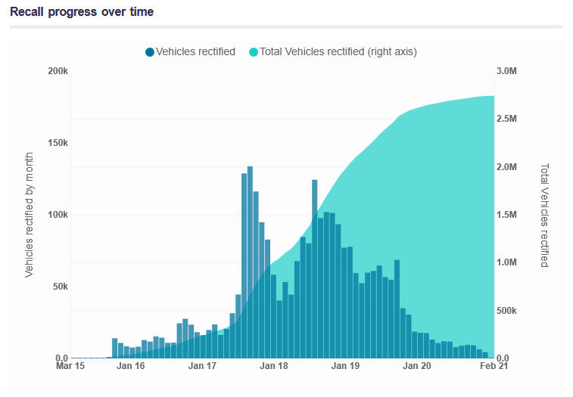

Slide 11
4. The NSW Coronial Inquest (2019-2021)
Inquest into death of Mr Huy Neng Ngo (born Cambodia, migrant to Australia)
23 hearing days from September 2019 to July 2020 (despite COVID pandemic)
242-page Findings report released 19 November 2021
Deputy State Coroner Magistrate Elaine Truscott
Counsel Assisting: David Kell SC & Ms TL Phillips (instructed by NSW Crown Solicitor's Office)
Honda Australia, ACCC & TD all represented by senior counsel & major law firms
Inquisitorial process: not litigation with ‘parties’; aimed at discovering truth; findings re cause of death + recommendations
But may lead to follow-on civil or even criminal proceedings

Slide 12
Key Inquest Findings – Honda Australia
Honda's recall letters failed to convey the importance of replacing the airbag
Use of "precautionary" language was "particularly regrettable" – suggested Honda was recalling as courtesy rather than legal requirement
Honda dealership delayed Mr Ngo's replacement by 3.5 months; should have accommodated earlier booking
Honda ceased monitoring its Salesforce system for delays from March 2017
Honda's payment structure for recall work contributed to dealer under-staffing
Coroner credited Honda's improved October 2017 recall letter as "vastly significant improvement" – but this came months after Mr Ngo's death

Slide 13
Key Findings – Regulatory Failures (1 of 2)
"Significant" & "substantial confusion" between ACCC & TD re their respective roles
TD claimed ACCC was "principal regulator"; ACCC's Grimwade said TD took the lead
Dean Wright (former ACCC Assistant Director, whistleblower): ACCC DID have responsibility to monitor recall effectiveness
TD had no systematic process to receive or review recall letters from Honda
ACCC understood TD was reviewing letters; TD said it lacked expertise to do so

Slide 14
Key Findings – Regulatory Failures (2 of 2)
Neither regulator raised concerns about Honda's "precautionary" language despite:
NRMA members' concerns raised with ACCC (September 2015)
Professor Nottage's concerns re Honda recall notices raised with three senior ACCC staff (December 2015)
Mazda airbag injury reported to ACCC (November 2015)
Coroner found ACCC & TD "inadequately administered & monitored" the voluntary recalls from July 2015 to July 2017

Slide 15
Inquest Recommendations
Five sets of recommendations for ongoing monitoring by TD & ACCC of all motor vehicle recalls
Due diligence requirements for Honda Australia & FCAI recalls Code
Independent inquiries & risk assessments when Australian firms receive recall notices from parent companies abroad
TD to study feasibility of Australian standard for airbags
Registration sanctions in NSW for vehicles subject to compulsory recall with unreplaced airbags
Most recommendations not contested; several already implemented or soon after (quite common with inquests)

Slide 16
Aftermath – Regulatory Impact
FCAI Code of Practice revised (September 2022) to incorporate due diligence recommendations
ACCC & TD improved MOU coordination, websites, & enforcement
Road Vehicle Safety Act 2018 gave TD compulsory recall powers
However: Inquest findings flew "largely under the radar" in media
ACCC whistleblower Dean Wright went public December 2021, alleging ACCC owed public an apology
Ongoing: 2024/2025 BMW Takata recalls still published confusingly across two websites (TD & ACCC PSA)
Singapore coronial inquest (2025-) into Takata fatality – NSW findings could assist

Slide 17
5. Inquest Aftermath – Private Litigation (1 of 2)
Class actions filed in NSW Supreme Court against Toyota, Subaru, Honda, BMW, Nissan, Mazda, VW (2017-2018)
February 2021: A$52 million settlement reached via mediation (7 days before retired Justice Bergin) – all manufacturers except VW
Average payout per vehicle owner: ~A$600 (after litigation funder fee, legal costs, administration)
Separate proceedings against VW: plaintiff Professor Dwyer lost – court found no proof of link between PSAN degradation & his specific airbag; no actual loss (airbag already replaced free)

Slide 18
Aftermath – Private Litigation & Regulatory (in)Action
If Inquest findings had been published earlier (before November 2021), could have influenced both settlement quantum, then VW case no-liability finding
ACCC fined Mercedes-Benz A$12.5 million (September 2022) for minimising Takata risks using "precautionary" language
ACCC did NOT proceed against Honda for similar language – possibly embarrassing given Inquest also found ACCC failures
Key insight: timing of inquest findings relative to ongoing litigation is critical to their impact on compensation outcomes

Slide 19
6. Other Product-Related Inquests – in Australia
NSW 2015: 14-year-old killed on motorised bicycle – Coroner recommended ban on conversion equipment (not implemented)
Victoria 2019: Man crushed by caravan using jockey-wheel as jack – recommended safety standard (not implemented)
NSW/Qld 2015-16: Multiple quad bike deaths – led to Consumer Goods (Quad Bikes) Safety Standard 2019
Problem: National Coronial Information System (established 2000) not easily searchable for product safety cases
Other suggested reform: require state AG to report on how federal recommendations have been passed on & responded to

Slide 20
Analogues Abroad – esp. Japan's CSIC
Nottage & Kozuka (2024) CCLJ https://ssrn.com/abstract=4459890
Consumer Safety Investigation Committee (CSIC) established 2012
Within Consumer Affairs Agency (created 2009 after major product safety failures)
Aims to identify causes of consumer accidents & propose counter-measures
Inspired partly by transport accident investigation & push from victim's family (elevator death)
Key difference from Australian inquests: CSIC is executive branch (not judicial); no public hearings; no subpoena powers; no Counsel Assisting
But supposed to remain independent; can advise Ministers on law reform
Also: Singapore coronial inquest into Takata fatality (2025); rectification rate only 94%, June 2024

Slide 21
7. Conclusions & Recommendations (1 of 2)
Unsafe Takata airbags circulating globally despite nearly two decades of recalls
The NSW Inquest uncovered how Honda Australia & regulators were "partly asleep at the wheel" on voluntary recalls
Coronial inquests can be a valuable resource for consumer product safety by:
Identifying serious product risks through inquisitorial fact-finding
Providing evidence that can assist compensation claims & class actions
Promoting regulatory learning & improving inter-agency coordination
Informing consumer product safety law reform debates

Slide 22
Key Conclusions & Recommendations (2 of 2)
Inquests should be better integrated into consumer product safety regulatory design & enforcement
Regulators should monitor & publicise coronial inquests (domestic & international) relevant to consumer product safety
Inquest findings should be released more promptly to maximise their impact on ongoing litigation & regulatory reform
A General Safety Provision should be added to the ACL to change supplier mindset from reactive recalls to pro-active safety assessment & management

